Slide 1

EECE 451 Project
Network Cell Analyzer
Team Members:
Ali rammal, Abdel Rahman El Kouche
karim abou daher, karim dib

Slide 2


Project Overview
Android app for real-time cellular network monitoring
Uses Flask for backend and PostgreSQL for data management
Collects signal strength, SNR, network type, and more
Visualizes data for easy interpretation
Helps users assess and improve connectivity

Slide 3
Objectives
Real-time collection of cellular network data.
Detailed statistical analysis of network types and operators.
User-friendly interface for data visualization.
Reliable backend infrastructure for data handling.

Slide 4
Application Architecture
Frontend: Android Studio(Kotlin)
Backend: Flask Framework (Python)
Database: Utilizes Supabase, which connects to a PostgreSQL backend for robust data storage and is hosted on AWS.
Server-client communication via HTTP Requests

Slide 5
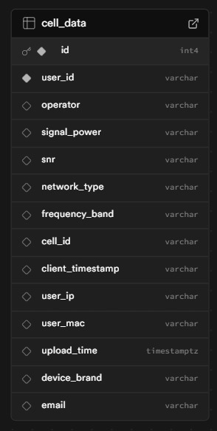
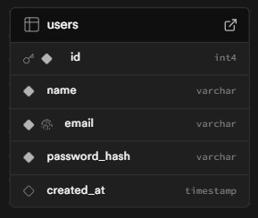
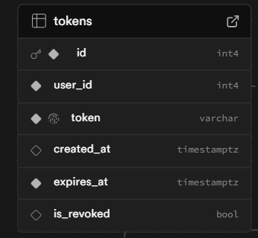
Database Schema
User management and authentication using tokenization for security.
Comprehensive cellular data records.
Structured tables for network metrics (signal strength, SNR, etc.)

Slide 6
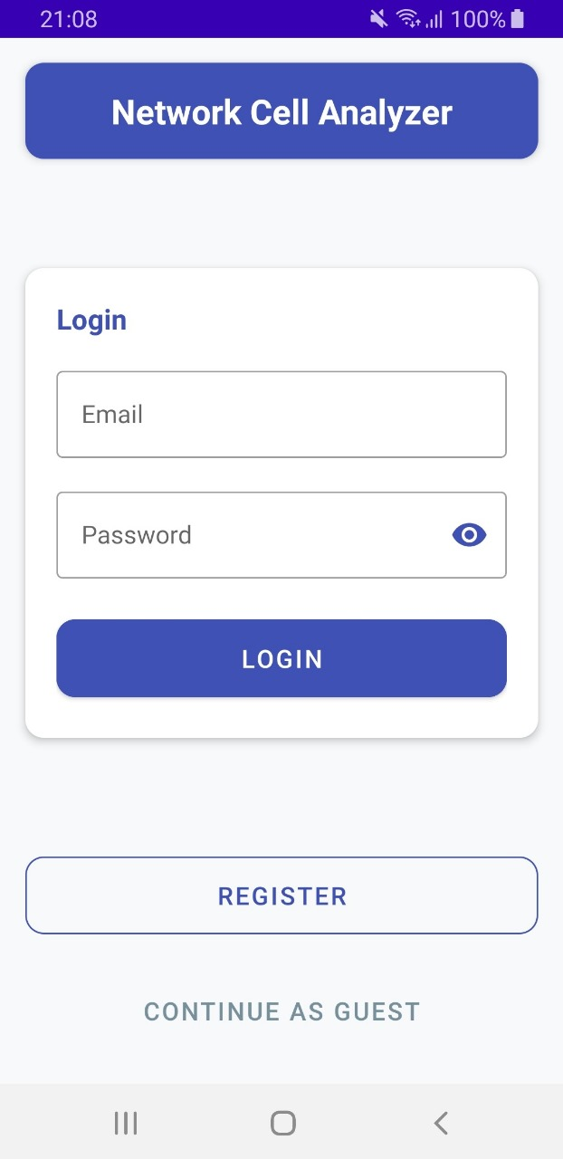
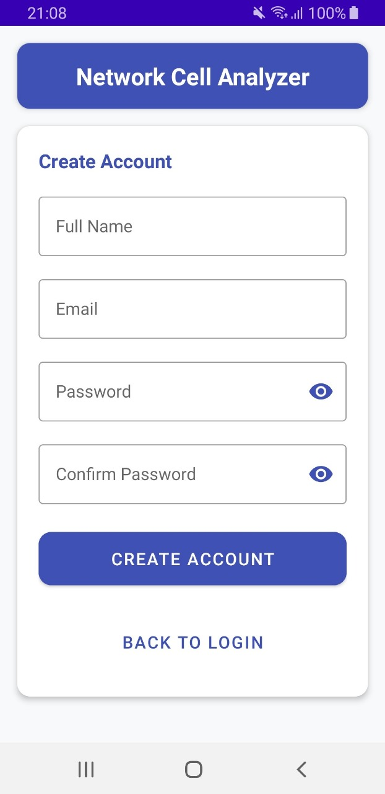
User Interface Authentication
Secure login system
Easy-to-use registration form
Password encryption for secure storage

Slide 7
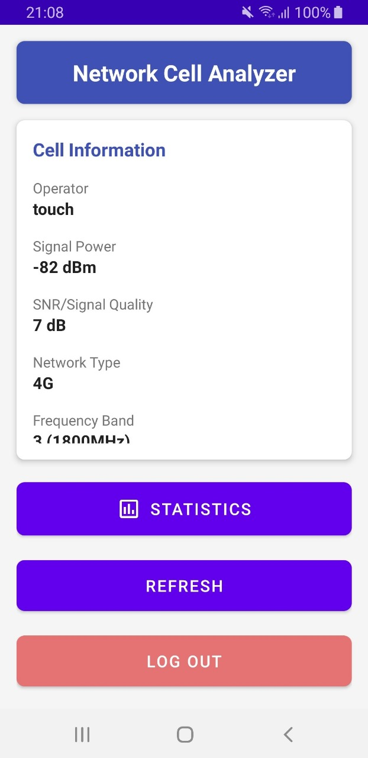
Key Features
Real-Time Network Monitoring
Detailed Stats & Trends
Frequency Band Identification
Secure User Login & Authentication
Interactive Visualizations

Slide 8

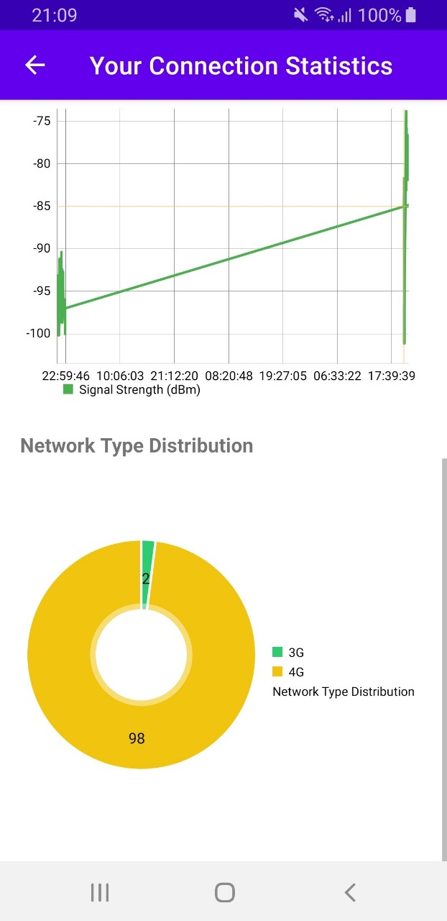
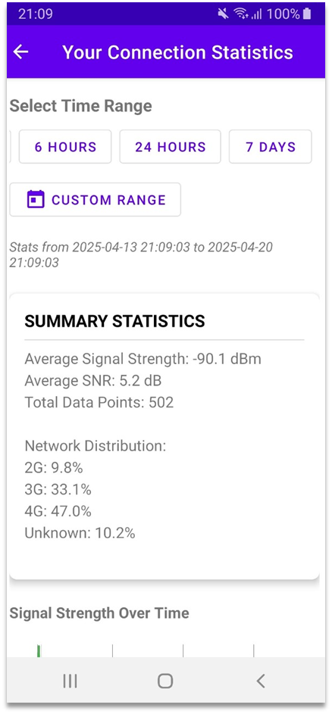
Statistical Analysis
Signal Strength Variation Analysis
Operator Usage & Distribution
Network Type Utilization Stats

Slide 9
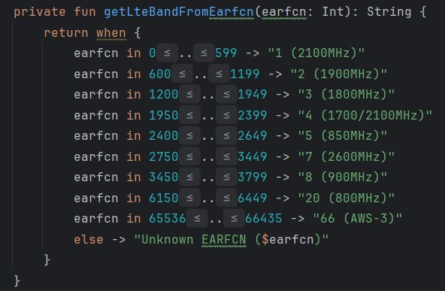
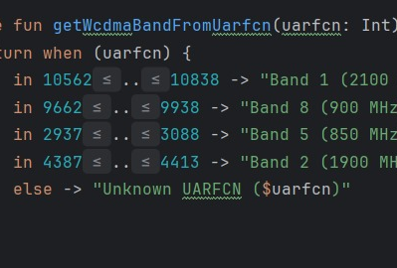
Frequency Band Detection
Automatically detecs LTE, NR (5G), WCDMA (3G), and GSM bands
Translates EARFCN, NRARFCN, UARFCN, and ARFCN codes into bands ARFCN → 2G UARFCN → 3G EARFCN → 4G NRARFCN → 5G

Slide 10

SNR Detection
5G (NR):Uses ssSinr or csiSinr directly from TelephonyManager.
4G (LTE):Retrieves rssnr directly from TelephonyManager.
3G (WCDMA): Uses Ec/Io (Energy per Chip to Interference ratio). It is an indicator of the cleanliness of the signal received from the tower.
2G (GSM):No direct SNR function available. Uses Bit Error Rate (BER) to estimate signal quality It is shown as: Excellent (BER < 0.2%), Fair, Poor, etc.

Slide 11
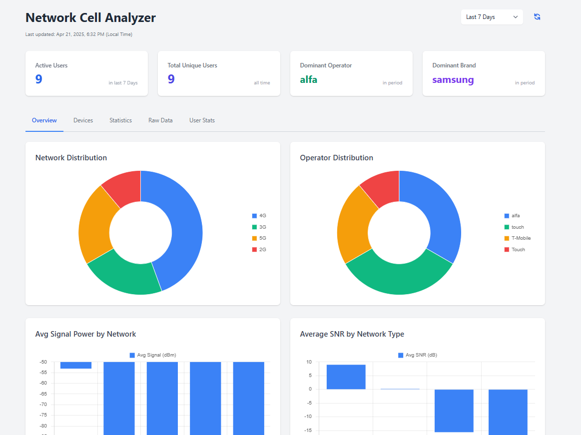
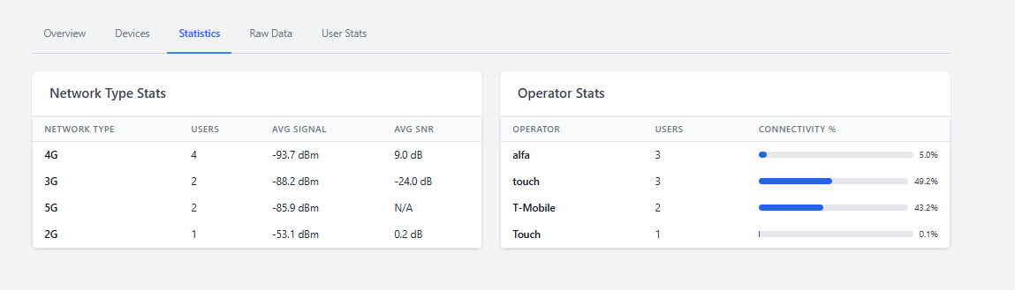
Server Interface
Real-Time Monitoring Dashboard
Detailed Stats & User Activity Logs
User-Friendly Admin Tools

Slide 12

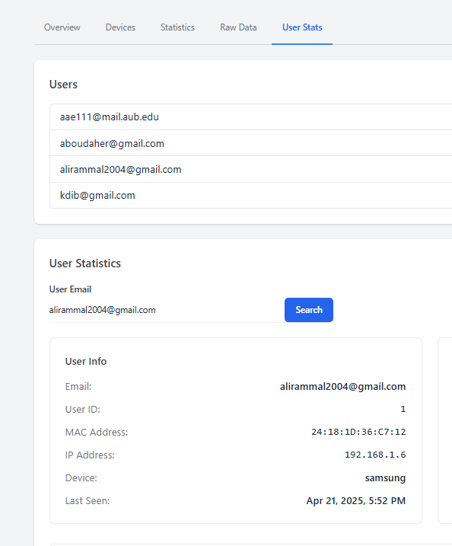



Also features searching for a specific user, using their email.

Slide 13
Server-Application Communication
Utilizes robust and asynchronous HTTP requests
JSON data format for efficiency
Responsive UI with
Continuous data refresh from the server in the background

Slide 14
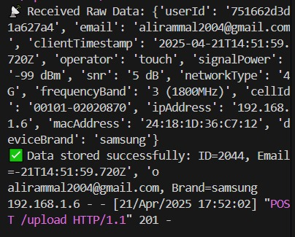
Testing and Validation
Live Testing via Flask API Interactions
Tested on Emulators and Real Devices
Backend Log & Supabase Console Monitoring

Slide 15
Challenges Encountered
Performance issues with Android Studio
Permission handling complexities
Technical issues with statistical data accuracy
Accessing the correct functions from TelephonyManager
Testing and validating backend queries across Supabase and Flask API

Slide 16

Future Improvements
Real-time alerts for poor signal conditions or coverage gaps
Add AI-based anomaly detection in signal and network patterns
Launch iOS version to reach a wider user base

Slide 17
Division of Work
Ali Rammal: Android app, backend development
Karim Abou Daher: UI design, powerpoint
Karim DIb: testing, server setup and report
Abdel Rahman El Kouche: server setup, server interface and database setup

Slide 18
Conclusion
The Network Cell Analyzer successfully demonstrates effective use of modern technology for cellular network analysis.
Despite challenges, the project accomplished its objectives, offering users valuable insights into their network environments and laying a solid foundation for future advancements.

Slide 19
DEMO

